Slide 1
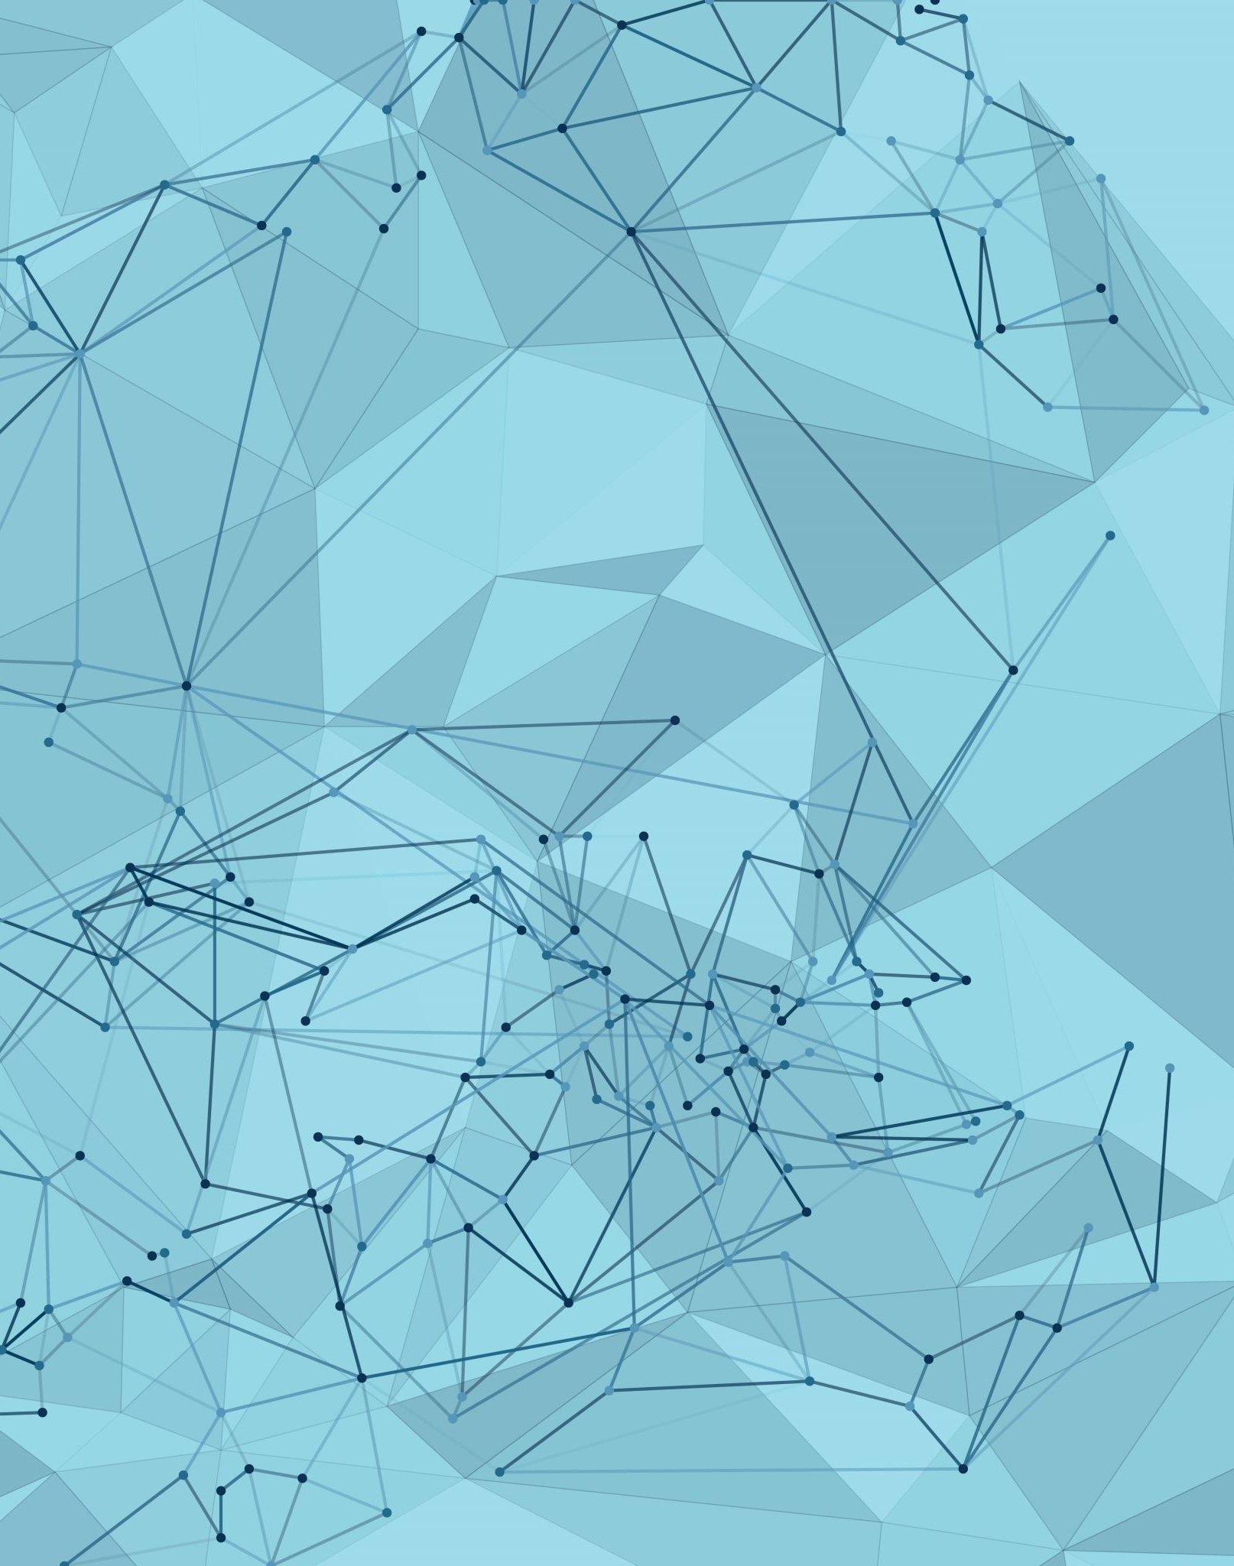
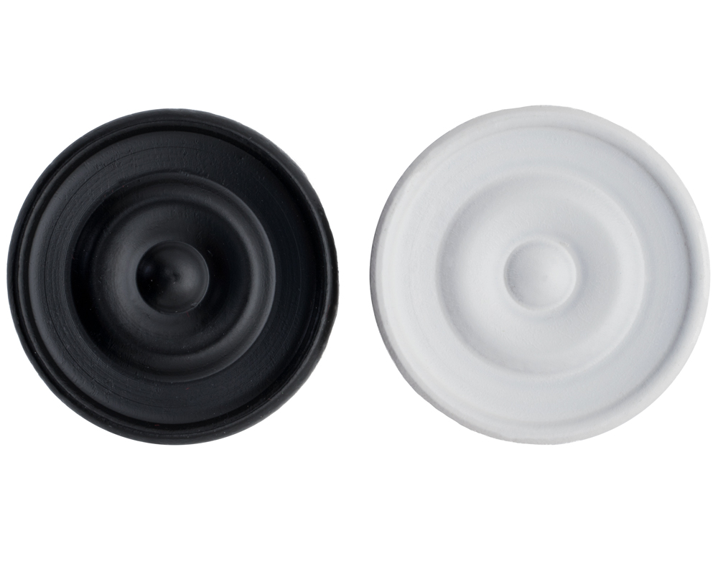
AI plays checkers
Jesus Pardo - 22202392

Slide 2
· Create an AI bot that can beat playing Checkers other bots or real players. · Create and interface for playing against the AI or see how two bots can play against each other.
Introduction

Slide 3
· Create a checkers game and board using the python module pygame. · Use the algorithm Minimax programmed in python 3.9.16 to decide the movements of the AI.
Methodology

Slide 4
· Graphics Rendering · Input Handling · Event Management · Animation and Effects · Collision Detection · Sound and Music
Methodology: Pygame
· User Interface (UI)
· Game Logic and State Management
· AI Integration
· Customization and Styling
· Cross-Platform Compatibility

Slide 5
· Code Organization and Readability · Modularity and Reusability · Collaboration and Teamwork · Ease of Maintenance · Scalability · Version Control and History
Methodology: Repository structure
· Documentation
· Testing and Quality Assurance
· Deployment and Continuous Integration
· Reduced Technical Debt
· Onboarding and Knowledge Transfer
· Code Reviews

Slide 6
· Objective · Two-Player, Zero-Sum Games · Recursive Approach · Maximizing and Minimizing · Evaluation Function · Backpropagation
Methodology: Minimax algorithm
· Alpha-Beta Pruning
· Depth-Limited Search
· Challenges and Considerations
· Application Beyond Games
· Enhancements
· Future Directions

Slide 7
· Optimization Objective · Node Evaluation Order · Alpha and Beta Values · Pruning Conditions · Maximizing Player (Alpha) · Minimizing Player (Beta)
Methodology: Alpha-Beta pruning
· Efficiency Gain
· Depth-First Search:
· Impact on Complexity
· Use Cases
· Advanced Variants
· Trade-Offs and Limitations:

Slide 8
The game

Slide 9
· Deep Reinforcement Learning (DRL) · Policy Gradient Methods · Monte Carlo Tree Search (MCTS) · Transfer Learning · Ensemble Learning · Dynamic Learning Rates · Curriculum Learning · Hierarchical Reinforcement Learning
Possible Extensions
· Reward Shaping
· Exploration Strategies
· Adversarial Training
· Human-AI Collaboration
· Visual Recognition
· Multi-Agent Learning
· Real-Time Learning

Slide 10
Thank you for the attention

